Slide 1


Nigeria’s GDP Forecast
Group 3

Slide 2

Nigeria’s GDP Forecast
The Nigeria GDP Dataset:
Use the Naïve Approach to forecast
Use a three-year Moving Average to forecast
Use Exponential Smoothing to forecast
Use Simple Linear Regression to forecast
Use Forecast sheet to Forecast
Calculate the following to determine the best forecasting technique:
MAD
MSE
MAPE

Slide 3
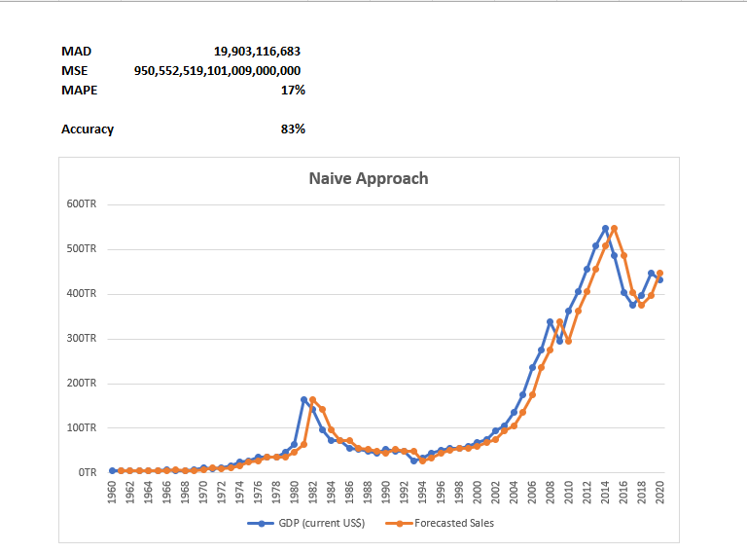
NAÏVE APPROACH
Using the Naïve approach, we were able to obtain the Mean Absolute Deviation(MAD) as 19,903116,683, the Mean Squared Error(MSE) as 950,552,519,101,009,000,000 and the Mean Absolute Percentage Error(MAPE) 17% thereby giving us an accuracy of 83%.

Slide 4
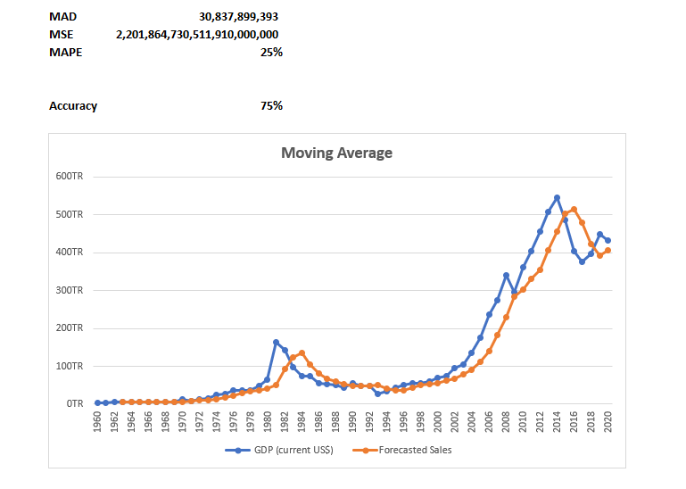
MOVING AVERAGE
Using the moving average, we were able to obtain the Mean Absolute Deviation(MAD) as 30,837,899,393 the Mean Squared Error(MSE) as 2,201,864,730,511,910,000,000 and the Mean Absolute Percentage Error(MAPE) 25% using a 3-year moving average thereby giving us an accuracy of 75%.

Slide 5
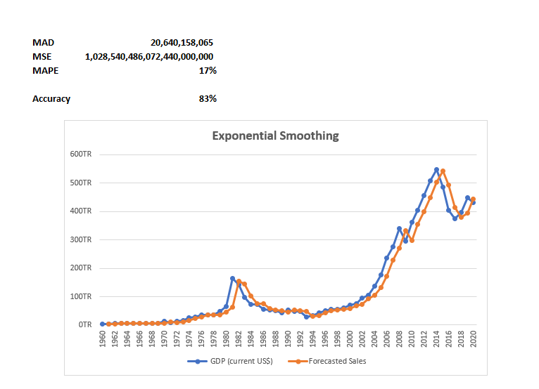
EXPONENTIAL SMOOTHING
Using the Exponential smoothing approach, we were able to obtain the Mean Absolute Deviation(MAD) as 20,640,158,065 the Mean Squared Error(MSE) as 1,028,540,486,072,440,000,000 and the Mean Absolute Percentage Error(MAPE) 17% with a dampening factor of 0.1 thereby giving us an accuracy of 83%.

Slide 6
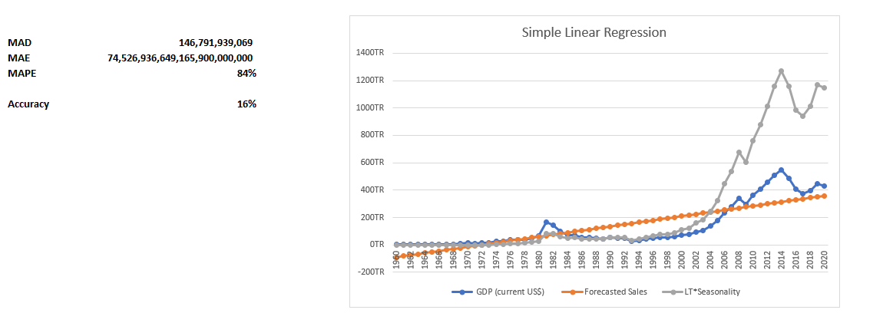
SIMPLE LINEAR REGRESSION
Using the Simple Linear Regression approach, we were able to obtain the Mean Absolute Deviation(MAD) as 146,791,939,069 the Mean Squared Error(MSE) as 74,526,936,649,165,900,000,000 and the Mean Absolute Percentage Error(MAPE) 84% putting into consideration the seasonality thereby giving us an accuracy of 16%.

Slide 7
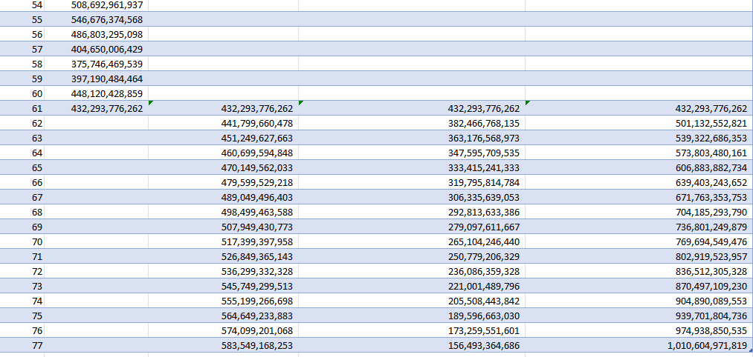
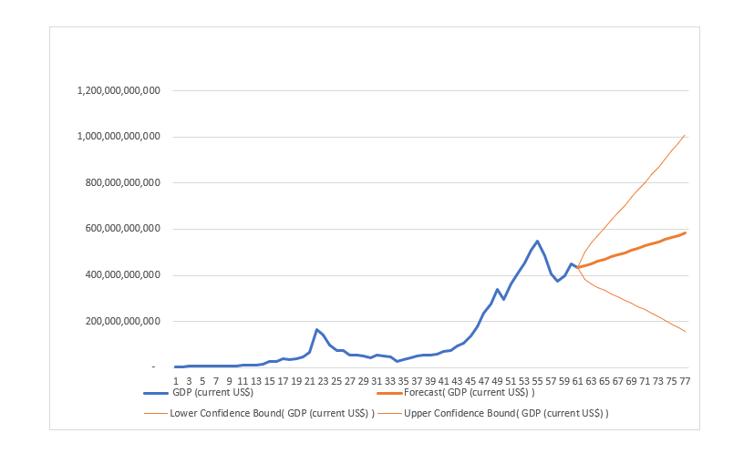

FORECAST SHEET
Using the Forecast sheet approach, we were able to obtain forecast for the following years with an upper confidence bound and a lower confidence bound which tells us that our cast lies within this range. For example, the highlighted figures shows the forecasted GDP as 441,799,660,478 with a lower bound of 382,466,768,135 and an upper bound of 501,132,552,821.

Slide 8
CONCLUSION
In conclusion, the GDP(USD) of Nigeria was forecasted for 1960 to 2020 using the following methods: Naïve approach, moving average, exponential smoothing, simple linear regression and forecast sheet.
Since the different methods has its pros and cons, hence, the need for evaluation to determine the accurate method. This evaluation was done mostly using Mean Absolute Deviation, Mean Squared Error and Mean Absolute Percentage Error. Since humans mostly understand the “percentage language”, the accuracy was determined in percentage with the Naïve approach and the exponential smoothing both having a percentage accuracy of 83%.
In such a case where both approach/methods have the same Mean Absolute Percentage Error(MAPE), we use the Mean Absolute Deviation(MAD) to draw inference to determine which is closer or moving towards zero which from the chart we can see that it’s the Naïve approach. Therefore, to forecast the GDP of Nigeria, the Naïve approach showed the best method for forecasting given the available data in this situation.

